Slide 1
Development and Validation of MATLAB-Based 3D Multibody Kinematics and Dynamics Simulation Engine
Michael Vignos
ME 751
December 16th, 2016

Slide 2
Problem Statement
To development and validate a 3D multibody kinematics and dynamics simulation engine within MATLAB
Key Features:
Straight-forward to use
Ability to define a multibody system consisting of bodies, constraints (i.e. joints), and externally applied forces and torques
Ability to perform kinematics, inverse dynamics, and dynamics analyses

Slide 3
Key Feature #1:
Straight-forward to use

Slide 4
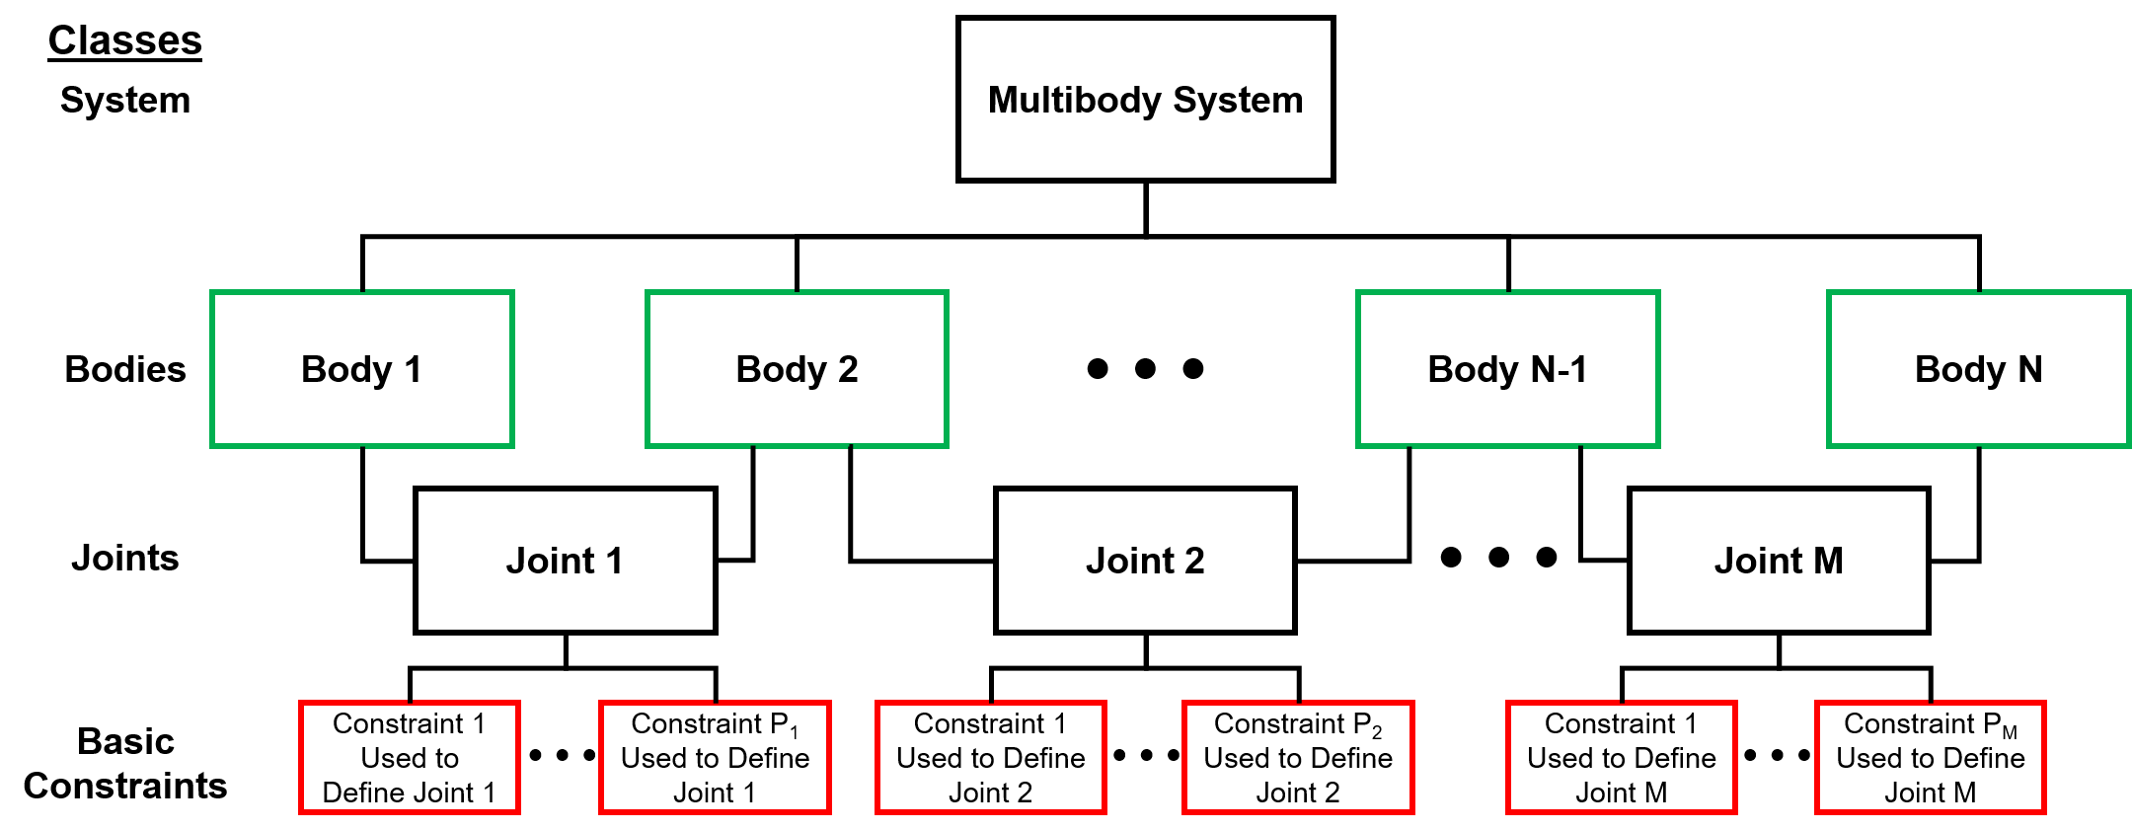
simEngine3D Structure

Slide 5
simEngine3D Structure
External forces and torques applied at the body level.

Slide 6
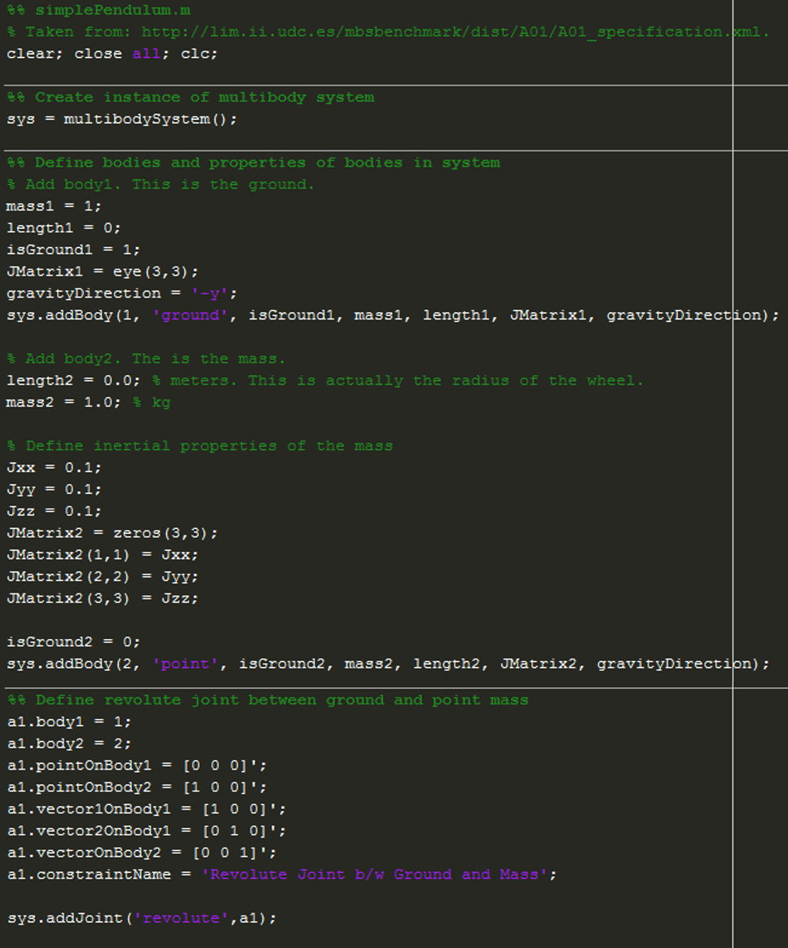
Example Model Definition
Create an instance of the multibody system class
Add a body to the system
Add a joint to the system

Slide 7
Key Feature #2:
Ability to define bodies, constraints (i.e. joints), and externally applied forces and torques

Slide 8
Validated Constraints and Joints
Basic Constraints
Dot Product 1 constraint
Dot Product 2 constraint
Distance constraint
Coordinate difference constraint
Intermediate Constraints
Parallel 1 constraint
Parallel 2 constraints
Joints
Spherical
Revolute
Cylindrical
Translational
Universal
Revolute-Cylindrical

Slide 9
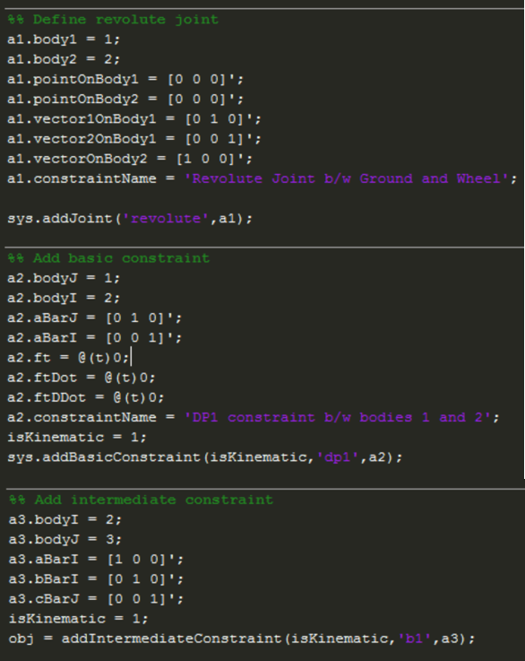
Adding Constraints to System

Slide 10
Force and Torque Options
Constant Force and Torque
Gravity force added once the body is added to the system
Moment of inertia defined by user
Variable Torque
Translational-Spring-Damper-Actuator

Slide 11
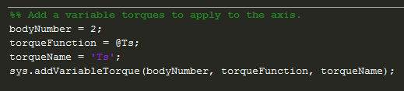
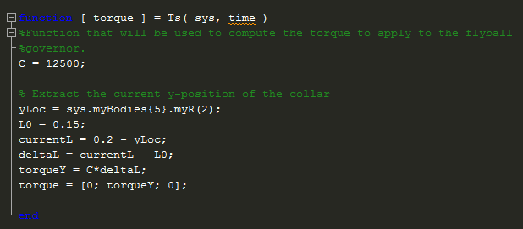
Variable Torque
Adding a variable torque to system
Variable torque function

Slide 12
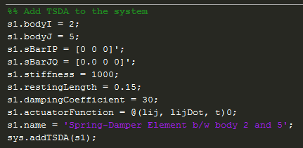
TSDA
Definition of force magnitude and direction taken from textbook

Slide 13
Key Feature #3:
Ability to perform kinematics, inverse dynamics, and dynamics analyses

Slide 14
Analysis of Mechanisms
STEPS:
Prescribe initial pose
Perform assembly analysis to ensure pose is consistent with constraints
If performing dynamics analysis, prescribe or compute initial velocities
Perform analysis
Kinematics
Inverse dynamics
Dynamics

Slide 15
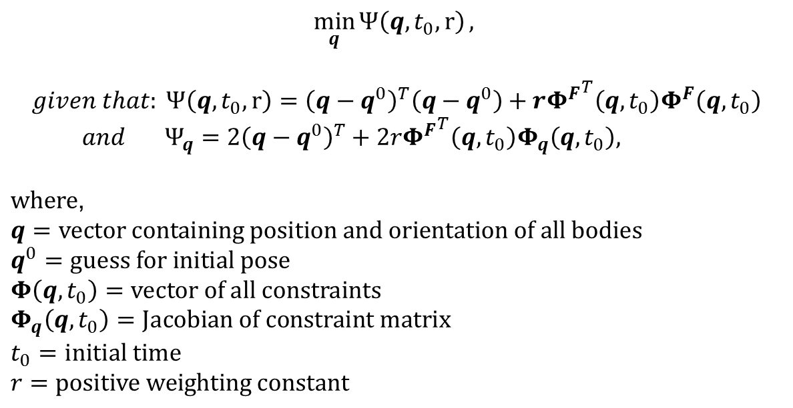
Assembly Analysis
Needed to ensure initial pose of mechanism is consistent with constraints
$$\min_{q}{Ψ\left(q,t_{0},r\right)},$$
$$given that: Ψ\left(q,t_{0},r\right)={\left(q−q^{0}\right)}^{T}\left(q−q^{0}\right)+r{Φ^{F}}^{T}\left(q,t_{0}\right)Φ^{F}\left(q,t_{0}\right)$$
$and Ψ_{q}=2{\left(q−q^{0}\right)}^{T}+2r{Φ^{F}}^{T}\left(q,t_{0}\right)Φ_{q}\left(q,t_{0}\right),$
$where$,
$$q=vector containing position and orientation of all bodies$$
$$q^{0}=guess for initial pose$$
$$Φ\left(q,t_{0}\right)=vector of all constraints$$
$$Φ_{q}\left(q,t_{0}\right)=Jacobian of constraint matrix$$
$$t_{0}=initial time$$
$$r=positive weighting constant$$

Slide 16
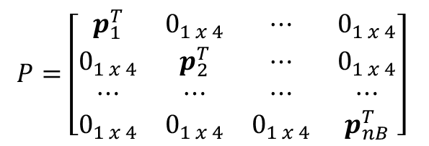
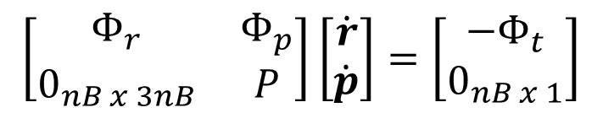
Computing Initial Velocities
No initial velocities known:
$$\left[\begin{matrix}Φ_{r} & Φ_{p} \\ 0_{nB x 3nB} & P\end{matrix}\right]\left[\begin{matrix}\dot{r} \\ \dot{p}\end{matrix}\right]=\left[\begin{matrix}−Φ_{t} \\ 0_{nB x 1}\end{matrix}\right]$$
$$P=\left[\begin{matrix}p_{1}^{T} & 0_{1 x 4} & ⋯ & 0_{1 x 4} \\ 0_{1 x 4} & p_{2}^{T} & ⋯ & 0_{1 x 4} \\ ⋯ & ⋯ & ⋯ & ⋯ \\ 0_{1 x 4} & 0_{1 x 4} & 0_{1 x 4} & p_{nB}^{T}\end{matrix}\right]$$
Subset of initial velocities known:
$$\left[\begin{matrix}Φ_{r_{unknown}} & Φ_{p_{unknown}} \\ 0_{{nB}_{unknown} x {3nB}_{unknown}} & P_{unknown}\end{matrix}\right]\left[\begin{matrix}{\dot{r}}_{unknown} \\ {\dot{p}}_{unknown}\end{matrix}\right]=\left[\begin{matrix}−Φ_{t}− Φ_{r_{known}}{\dot{r}}_{known}−Φ_{p_{known}}{\dot{p}}_{known} \\ 0_{{nB}_{unknown} x 1}\end{matrix}\right]$$

Slide 17
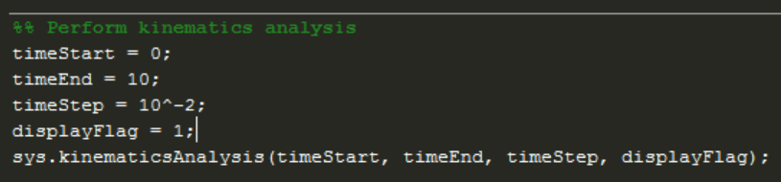
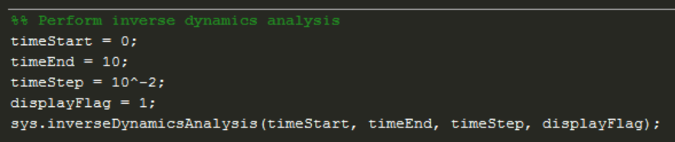
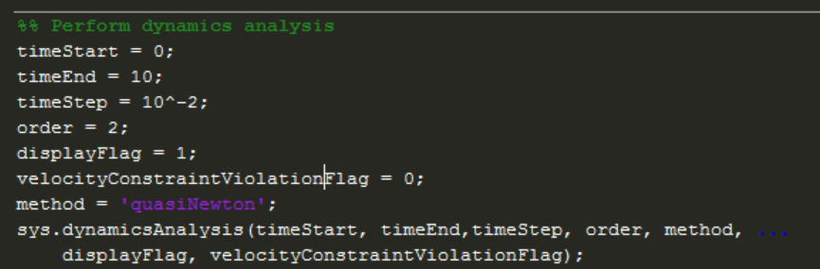
Performing Analyses
Kinematics
Inverse Dynamics
Dynamics

Slide 18
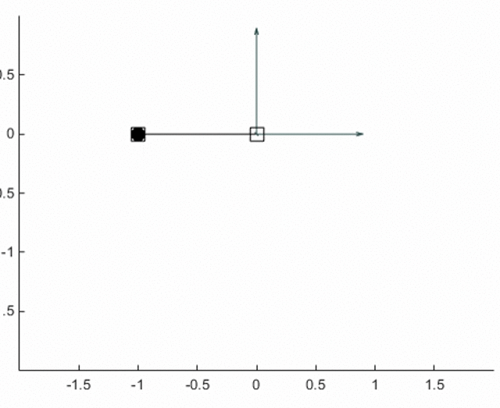
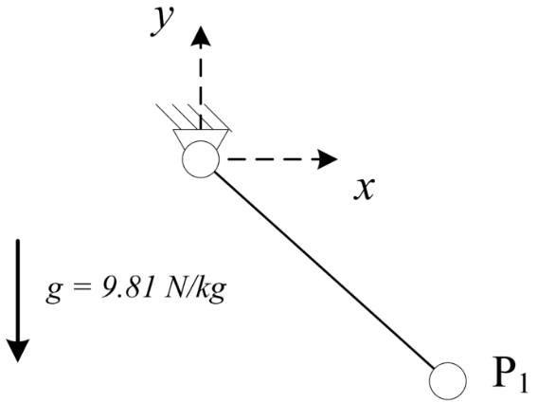
simEngine3D Validation
Validation of Revolute Joint and Comparison to Benchmark
Simple pendulum

Slide 19
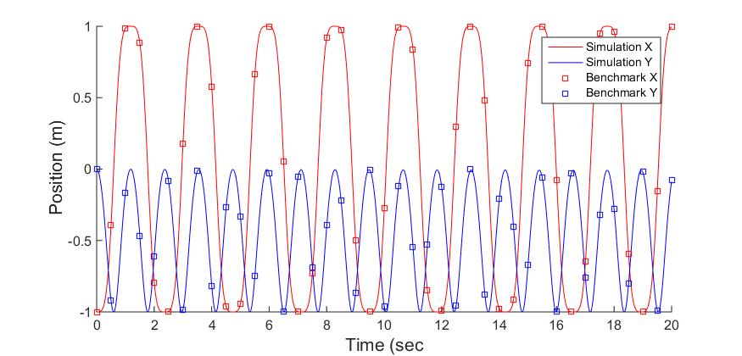
simEngine3D Validation
Validation of Revolute Joint and Comparison to Benchmark
Simple pendulum

Slide 20
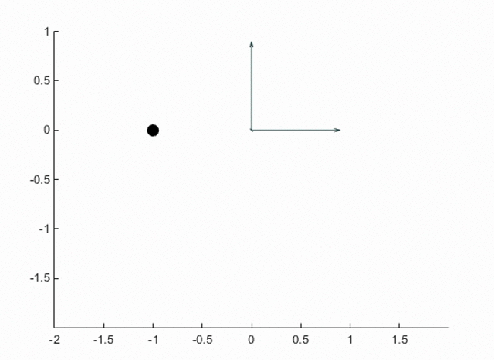
Simple Pendulum with Cylindrical Joint
Force of 1N applied to mass in +Z direction
Validation of Cylindrical Joint

Slide 21
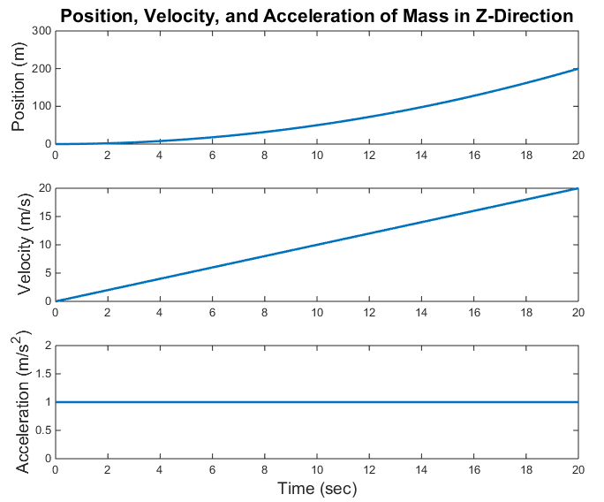
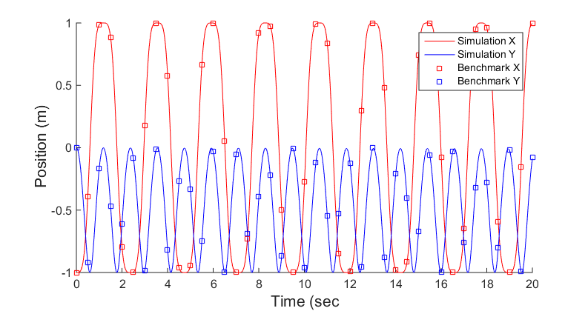
Simple Pendulum with Cylindrical Joint
Validation of Cylindrical Joint

Slide 22
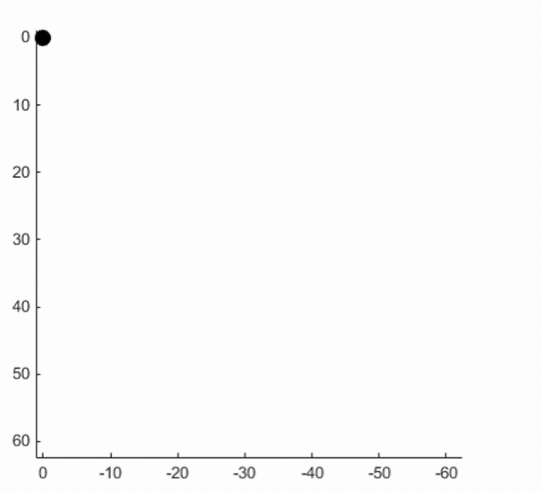
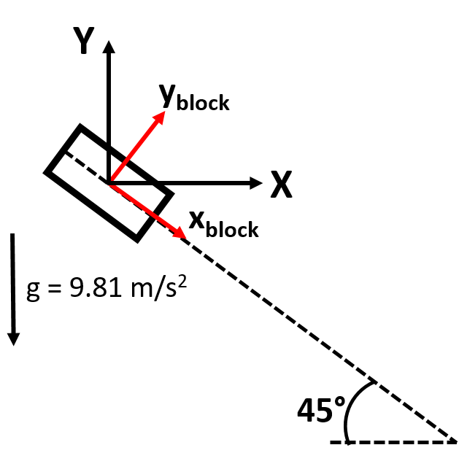
Block on Inclined Plane
Validation of Translational Joint

Slide 23
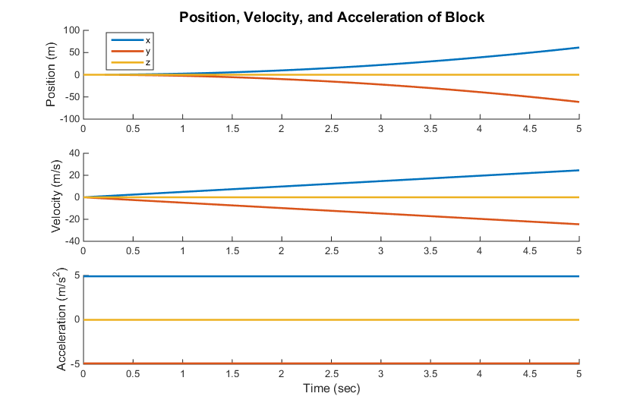
Block on Inclined Plane
Validation of Translational Joint

Slide 24
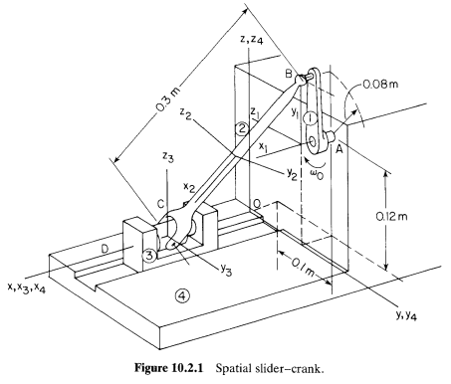
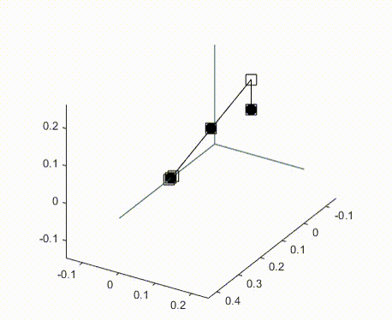
Spatial Slider-Crank
Validation of Spherical and Revolute Cylindrical Joint
Constant angular velocity of 2π rad/sec applied to crank

Slide 25
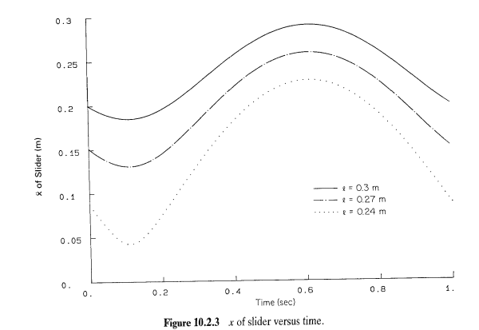
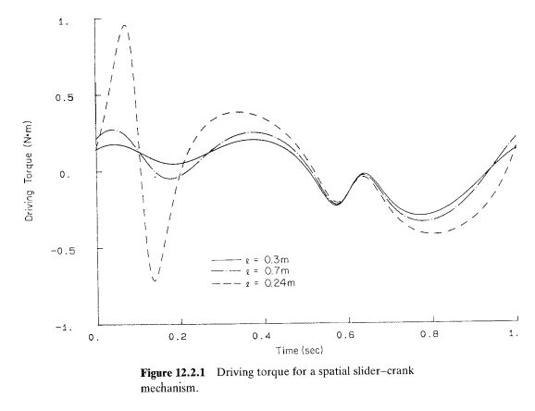
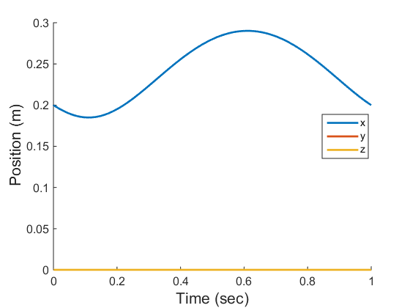
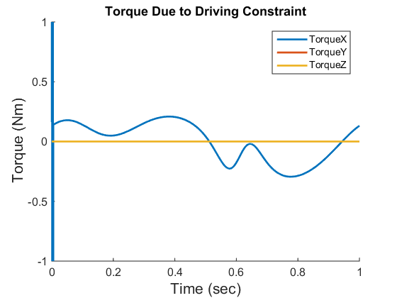
Spatial Slider-Crank
Validation of Spherical and Revolute Cylindrical Joint

Slide 26
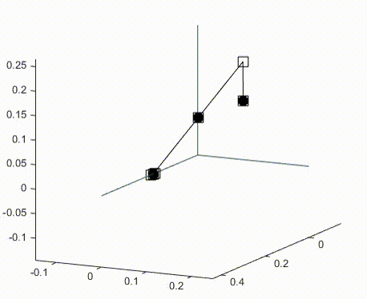
Spatial Slider-Crank
Validation of Spherical and Revolute Cylindrical Joint
Initial angular velocity of 6 rad/sec applied to crank

Slide 27
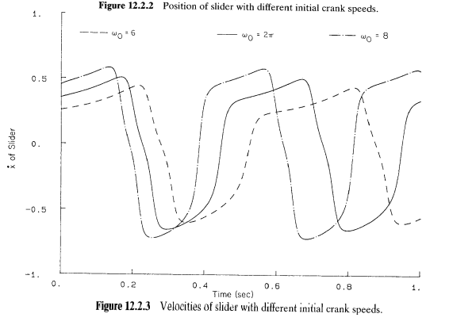
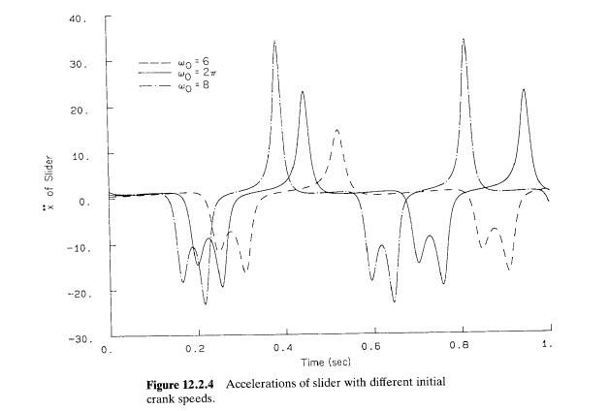
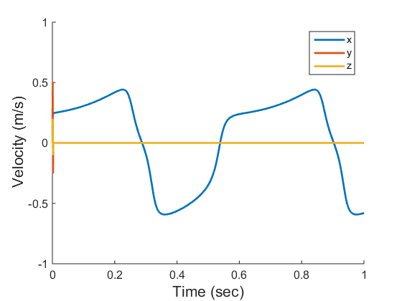
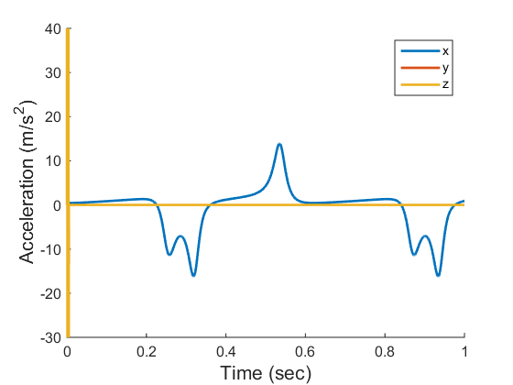
Spatial Slider-Crank
Validation of Spherical and Revolute Cylindrical Joint

Slide 28
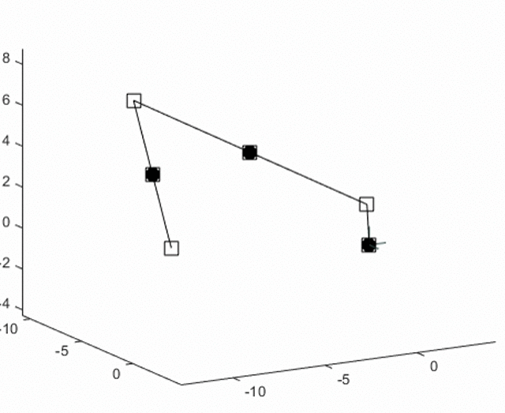
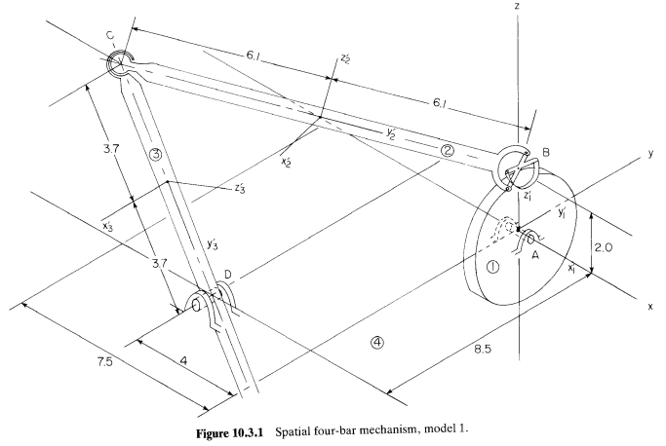
Four-Bar Mechanism
Validation of Universal Joint
Constant angular velocity of π applied to wheel

Slide 29
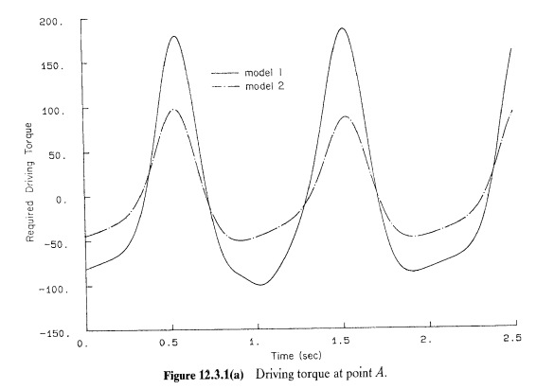
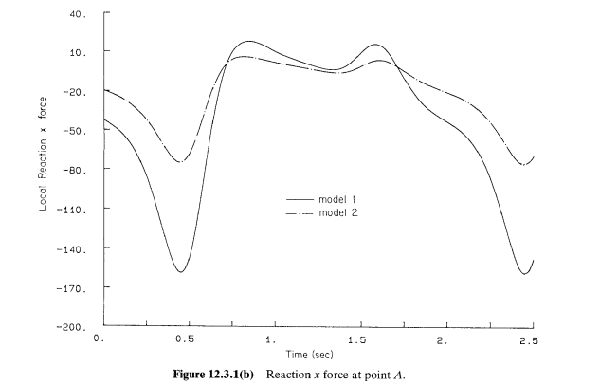
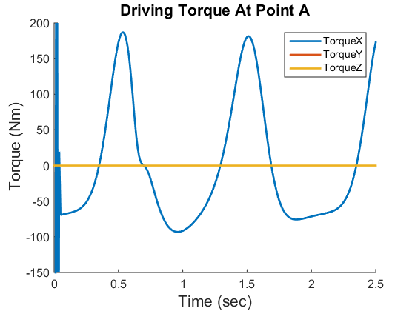
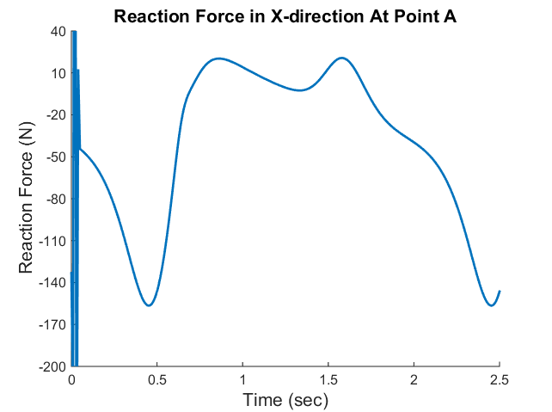
Four-Bar Mechanism
Validation of Universal Joint

Slide 30
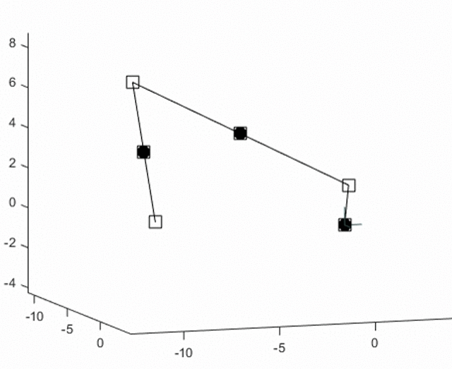
Four-Bar Mechanism Cont.
Validation of Constant Torque Component
CCW torque of 10 Nm applied to wheel

Slide 31
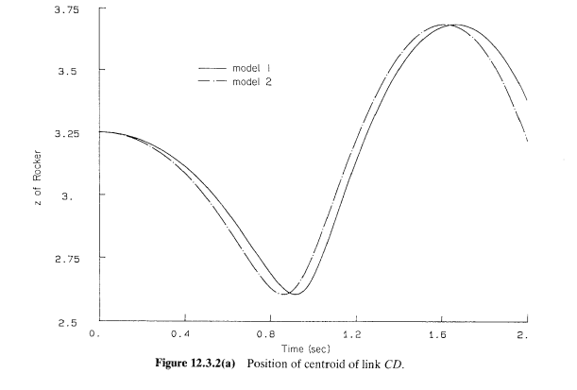
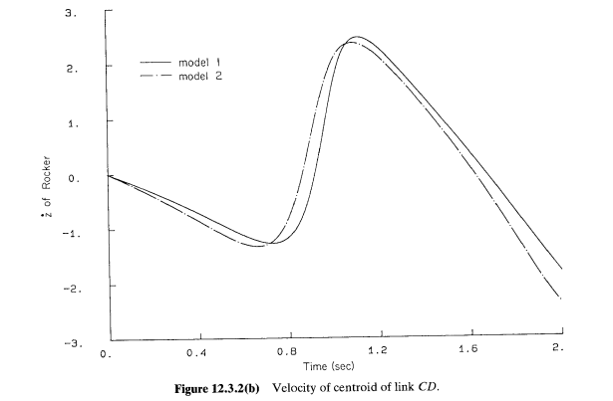
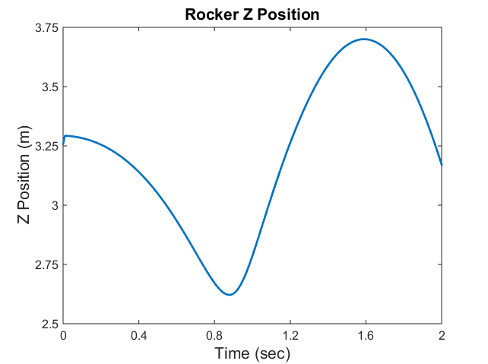
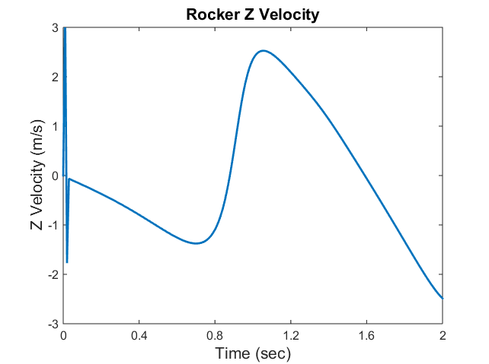
Four-Bar Mechanism Cont.
Validation of Constant Torque Component

Slide 32
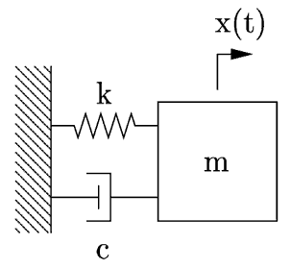
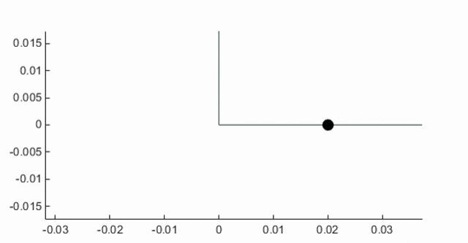
Mass-Spring-Damper
Validation of TSDA

Slide 33
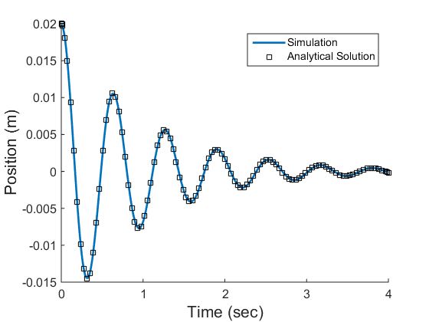
Mass-Spring-Damper
Validation of TSDA

Slide 34
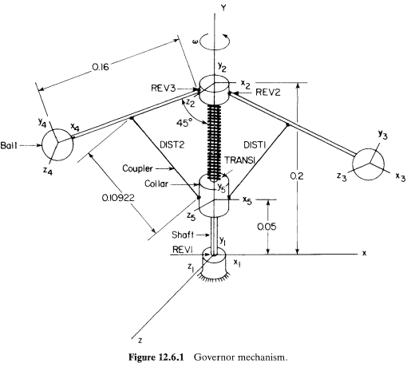
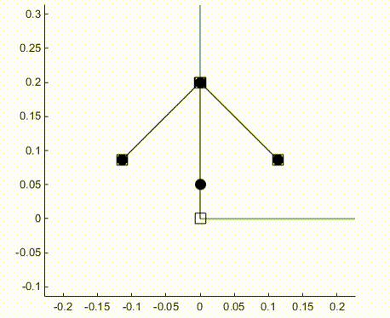
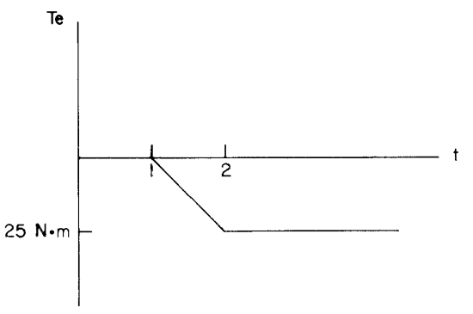
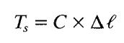
Flyball Governor
Validation of Variable Torque Component
Initial velocity of 11.02 rad/sec applied to axis. Two variable torques applied to axis
1st variable torque:
2nd variable torque:

Slide 35




Flyball Governor
Validation of Variable Torque Component

Slide 36


Classic Four-Bar Mechanism
Comparison to Common Benchmark Problem
v₀ = 1m/s

Slide 37

Classic Four-Bar Mechanism
Comparison to Common Benchmark Problem

